Slide 1


Example
Experiment: single dice roll
Outcomes are just 1,2,3,4,5,6.
Events are the set of all subsets
Closed under unions and intersections
There are 64 events
The probability of an event = (# of elements in the event) x 1/6
E.g.,

Slide 2

Twist on Example
Same list of events
So far covers events with single outcome.
If event contains multiple outcomes, just add probabilities

Slide 3

Alternate Example
Experiment: Single dice roll (same as before)
There are only 4 events: (different than before)
Closed under unions and intersections
Tells if outcome is even or odd
The probability of an event = (# of elements in the event) x 1/6

Slide 4
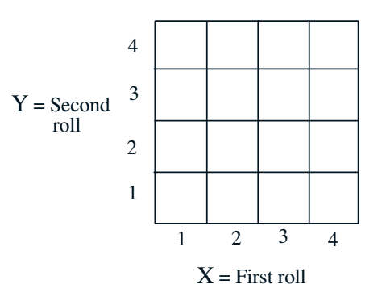
Discrete Example Cont’
Recall two rolls of a tetrahedral die
Events are collections of boxes
Probabilities of events = # of boxes / 16

Slide 5
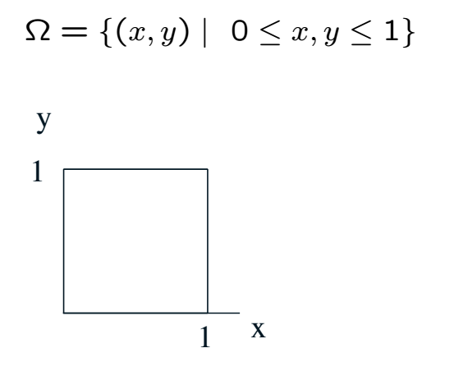
Continuous Example Cont’
Events are regions in the box
Probabilities of events = Area of region

Slide 6
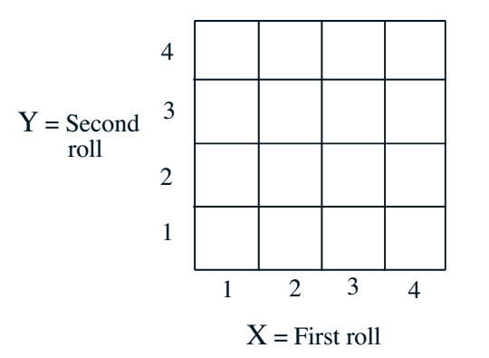
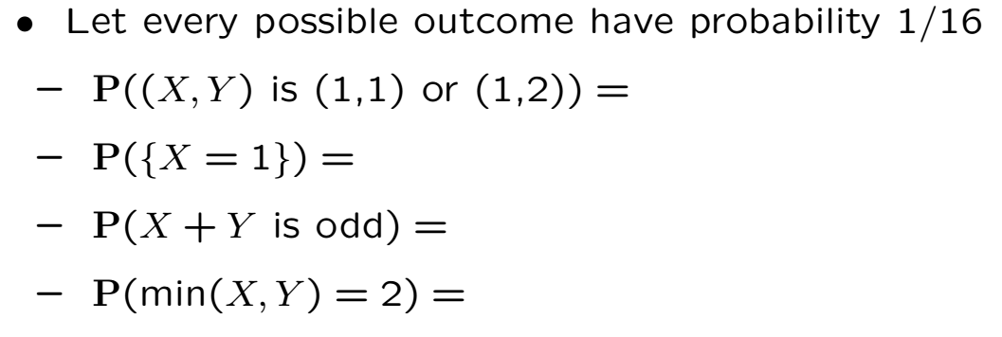
Finite Sample Space Example

Slide 7
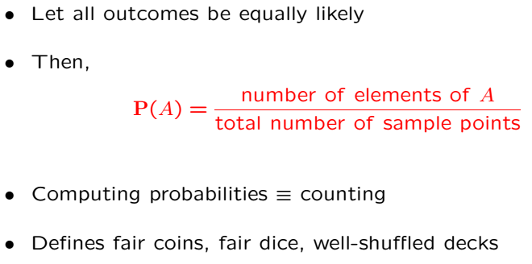
Discrete Uniform Law

Slide 8
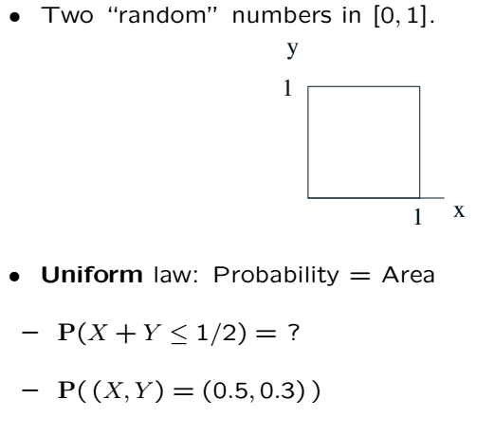
Continuous Uniform Law

Slide 9
Acknowledgements and Citations
Parts of these slides are adapted from the following resources:
Power Point Lecture Slides for the Textbook http://bcs.wiley.com/hebcs/Books?action=index&bcsId=8676&itemId=1118324560
John Tsitsiklis. 6.041 Probabilistic Systems Analysis and Applied Probability, Fall 2010. (Massachusetts Institute of Technology: MIT OpenCourseWare),http://ocw.mit.edu (Accessed 13 Apr, 2015). License: Creative Commons BY-NC-SA

